Slide 1
Fracture
UNIVERSITY OF BASRAH /COLLEGE OF VETERINARY MEDICINE /DEPARTMENT OF VET. SURGERY AND OBSTITRIC
Dr. ALAA A. IBRAHIM

Slide 2
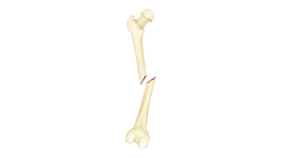
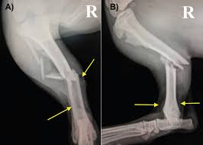
Definition of fracture
A fracture is a complete or incomplete break in the continuity of bone or cartilage
Classification of fractures
Fractures may be classified on many bases include causal factors; presence of a communicating external wound; location, morphology, and severity of the fracture; and stability of the fracture after axial reduction of the fragments

Slide 3
1-Causal Factors
Direct Violence Applied to Bone (car accidents or motorized vehicles)
Indirect Violence: The force is transmitted through bone or muscle to a distant point where the fracture occurs (e.g., fracture of femoral neck, avulsion of tibial tubercle, fracture of condyles of the humerus or femur)
Diseases of Bone. Some bone diseases cause bone destruction or weakening to such a degree that trivial trauma may produce a fracture (e.g., bone neoplasms, nutritional disturbances affecting bone).
Repeated Stress. Fatigue fractures in small animals are most frequently encountered in bones of the front or rear foot (e.g., metacarpal or metatarsal bones in the racing greyhound).

Slide 4
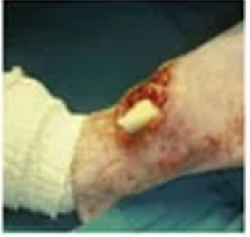
2-Presence of Communicating External Wound
Closed Fracture.: The fracture does not communicate to the outside (skin is close)
Open Fracture:- The fracture site communicates to the outside. These fractures are contaminated or infected, and healing at best may be complicated and delayed

Slide 5
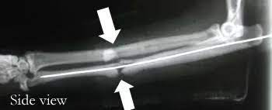
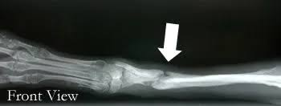
3- Location, Fracture Morphology, and Severity
Localization of the fracture is provided by numbering each long bone (1, humerus; 2, radius/ulna; 3, femur; 4, tibia/fibula) and dividing each bone into 1, proximal; 2, shaft; and 3, distal zones
Severity of the fracture :- each fracture is typed as A, simple; B, wedge; or C, complex. Each grade is further grouped into
three degrees of complexity (e.g., A1, A2, A3) depending on the type and extent of bone fragmentation.
Thus the simplest shaft fracture of the humerus would be characterized as “1 2 A1.”

Slide 6
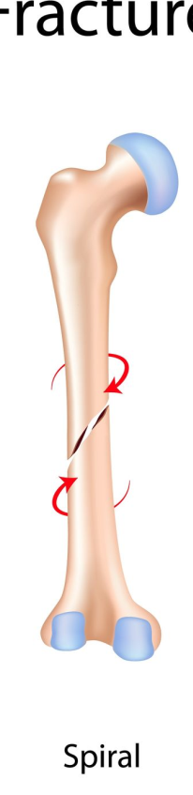
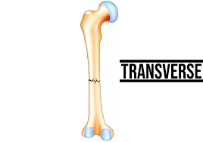
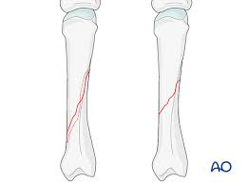
4- Orientation of fracture line relative to the bone’s long axis
Transverse Fracture :-The fracture crosses the bone at an angle of not more than 30 degrees to the long axis of the bone
Oblique Fracture :-The fracture describes an angle of greater than 30 degrees to the long axis of the bone
Spiral Fracture :-This is a special case of oblique fracture in which the fracture line curves around the diaphysis

Slide 7
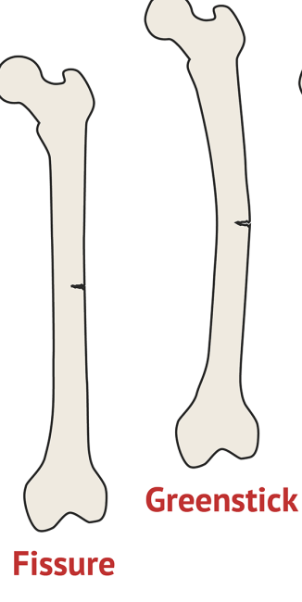
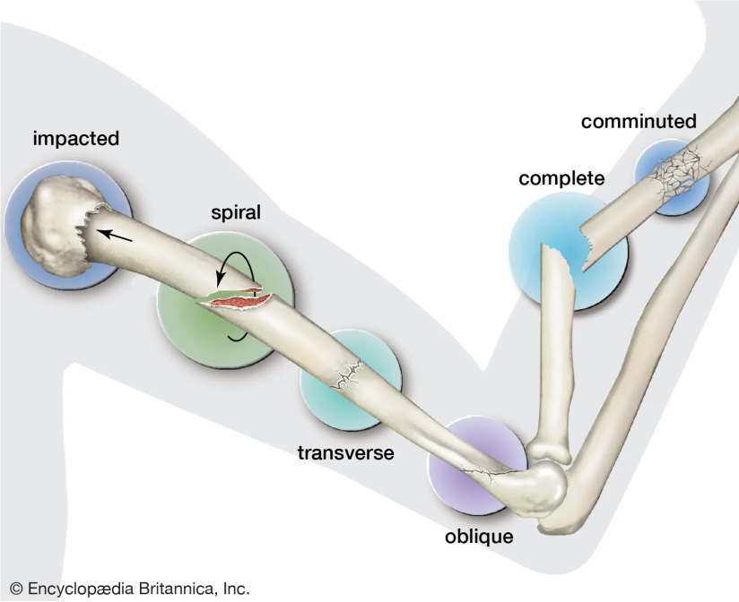
5- The extent of damage
Incomplete Fracture :- is used to describe a fracture that only disrupts one cortex,
an incomplete fracture is called a greenstick fracture in young animals because of the bending of the nonfractured cortex.
Fissure fractures exhibit fine cracks that penetrate the cortex in a linear or spiral direction
Complete Fracture. A complete fracture describes a single circumferential disruption of the bone.

Slide 8
Clinical signs of fracture
1. Pain or localized tenderness
2. Deformity or change in angulation
3. Abnormal mobility
4. Local swelling (This may appear almost immediately or not until several hours or a day after the accident. It usually persists for 7 to 10 days because of the disturbed flow of blood and lymph.)
5. Loss of function
6. Crepitus sound which is not cardinal sign of fracture because this signs is not found in incomplete fracture and this sound disappear when the soft tissue interposed between the fracture fragment

Slide 9
Fracture healing
Fracture healing :- is a complex process aimed to restore the damage bone to its pre-injury state and cellular composition.
There are two main types of bone healing, primary and secondary bone healing.
Primary (direct) healing occurs when the bony fragments are perfectly reduced, aligned, and fixed under compression with no motion at the fracture site.
Bone healing consists of four steps:
Hematoma formation
Granulation tissue formation
Bony callus formation
Bone remodeling

Slide 10
Hematoma Formation and Inflammatory Phase:
Inflammatory stage is initial response to fracture and it is a vital protective mechanism that initiates the healing process.
This stage involve release of various chemical inflammatory mediators, such as cytokines and growth factors, which recruit inflammatory cells to the fracture site and attract mesenchymal stem cells (MSCs) to initiate the next stage of healing.
Hematoma (clotted blood) form at fracture site result from disruption of blood vessels.
Hematoma serves as a scaffold for subsequent stages of bone healing.
Neutrophils and macrophages play crucial roles in removing debris and initiating tissue repair.
The inflammatory stage typically lasts for a few days.

Slide 11
Soft Callus Formation and Granulation Tissue Formation:
During this stage , mesenchymal stem cells (MSCs) differentiate into chondroblast (cells that form cartilage) and osteoblasts (cells that form bone) forming a soft callus
Soft callus composed fibrocartilage and collagen and this matrix bridges the fracture gap and simultaneously
Granulation tissue formation occur which is rich in blood vessels and fibroblasts
The soft callus acts as a temporary scaffold, stabilizing the fracture and allowing for the subsequent deposition of bone tissue
The soft callus stage typically lasts for a few weeks.

Slide 12
Hard Callus Formation and Endochondral Ossification:
Osteoblasts, which are responsible for bone formation, invade the soft callus and deposit new bone tissue. The soft callus gradually undergoes mineralization and transforms into a hard callus, composed of woven, immature bone. This process, known as endochondral ossification, involves the transformation of cartilage into bone. The hard callus provides structural stability and gradually bridges the fracture gap. This stage can last several months, depending on the severity and location of the fracture.

Slide 13
Remodeling Phase:
The remodeling phase is the final stage of bone healing, where the newly formed woven bone is reshaped into its mature and mechanically sound structure. Osteoclasts (another type of specialized bone cell) resorb excess bone. Simultaneously, osteoblasts deposit new bone tissue in a process called bone modeling. The remodeling process can take several years, during which the bone gradually adapts to its mechanical demands.

Slide 14
Treatment of fracture
Fracture treatment include :-
First aid
Fracture reduction
Fracture fixation
Giving antibiotics to prevent secondary bacterial infections (using broad spectrum like Ceftriaxone ) and giving rest to the animal and restrict their movement
X-ray is use before fracture treatment for the following aims :-
To diagnose the fracture
To determine fracture location
To determined fracture type
To determine the technique(method ) used for fracture treatment

Slide 15
First aid
First aid include :-
Stop of bleeding if present to prevent blood loss which can be lead to shock (hypovolemic shock ) and animal death .
Fluid therapy
Using of temporary splint like coaptation splint

Slide 16
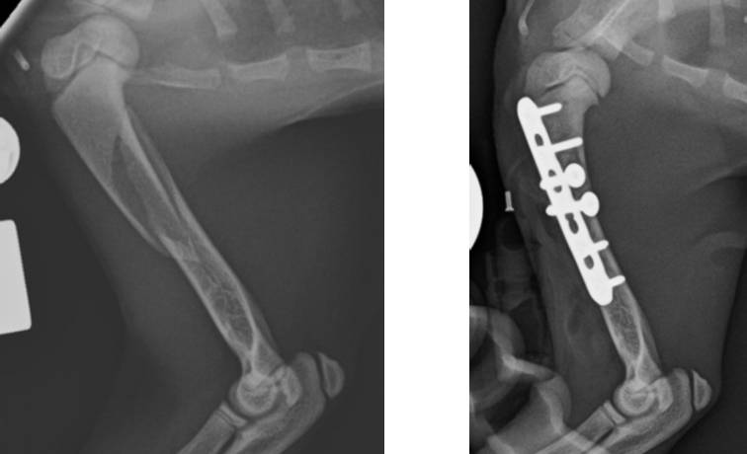
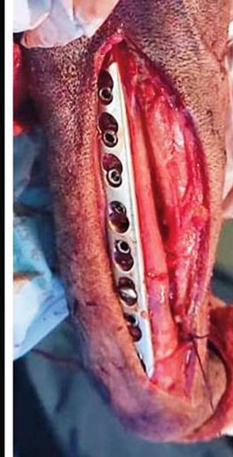
Fracture reduction
Reduction Reduction of a fracture refers to the process of replacing the fractured segments in their original anatomical position.
Fracture reduction is used only in complete fracture
There are tow types of fracture reduction (open and closed reduction )
Open fracture reduction is manual reduction of fracture ends to its normal position by surgical operation

Slide 17
Fracture reduction
Closed fracture reduction :- can be done by using
Traction and manipulation of the bone fragments.
Traction can be obtained by manual force or by gravity
The Gordon extender is a useful method of producing traction.
In skeletal traction, sterile pins or ice tong–like devices are attached to the distal fragment and traction is exerted on the device

Slide 18
Fracture fixation
The objectives of fixation are to stabilize the fragments and to prevent displacement, angulation, and rotation
Fracture fixation is by splint
The methods of fixation may be classified as follows:
1. Limb splintage (coaptation splints, casts, modified Thomas splint)
2. Bone splintage (intramedullary pin, external skeletal fixator, bone plate)
3. Compression (lag screw, cerclage/interfragmentary wire, tension band wire, tension band/compression plate)

Slide 19
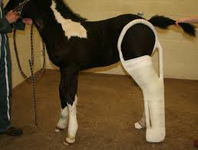
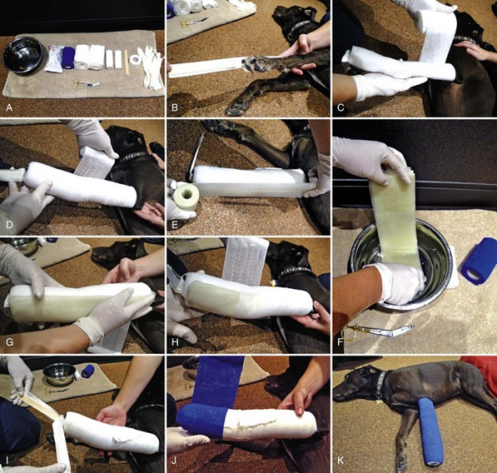
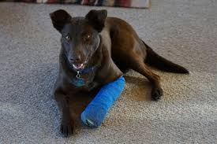
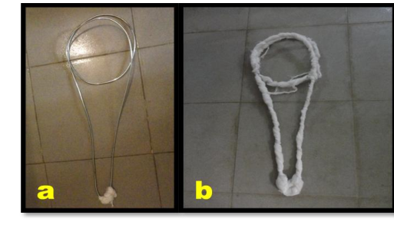
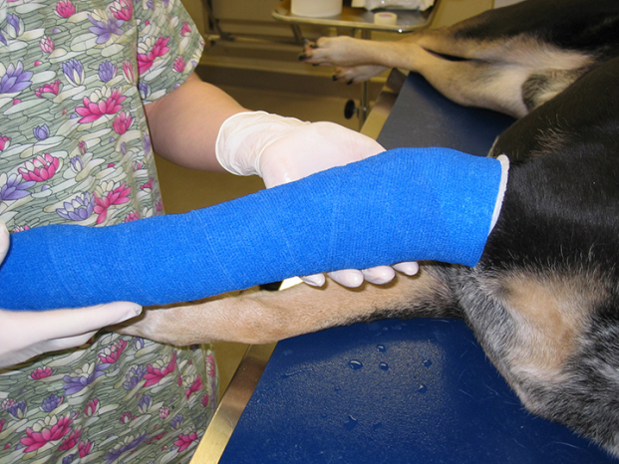
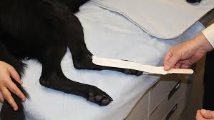
Thomas splint coaptation cast

Slide 20
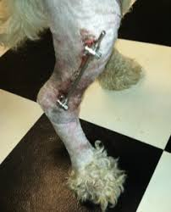
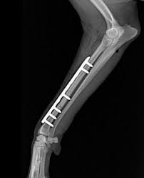
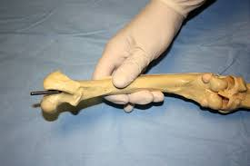
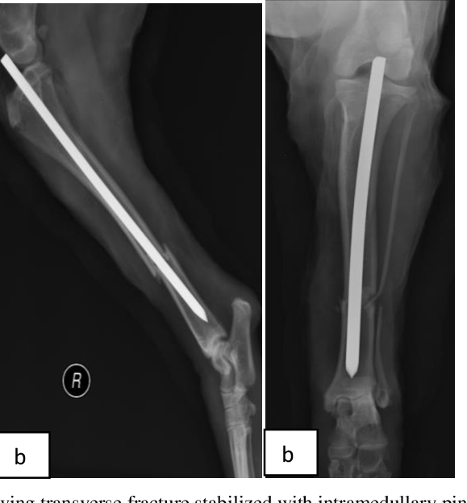
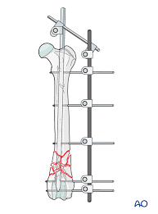
Intramedullary pin External skeletal fixator Bone plate

Slide 21
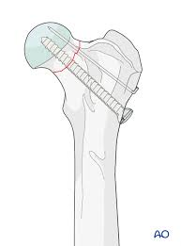
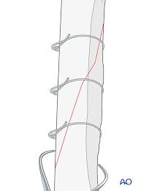
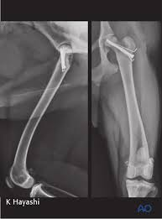
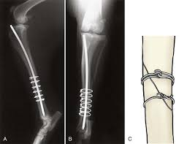
Leg screw cerclage/interfragmentary wire

